Slide 1


DevOps Community

Slide 2
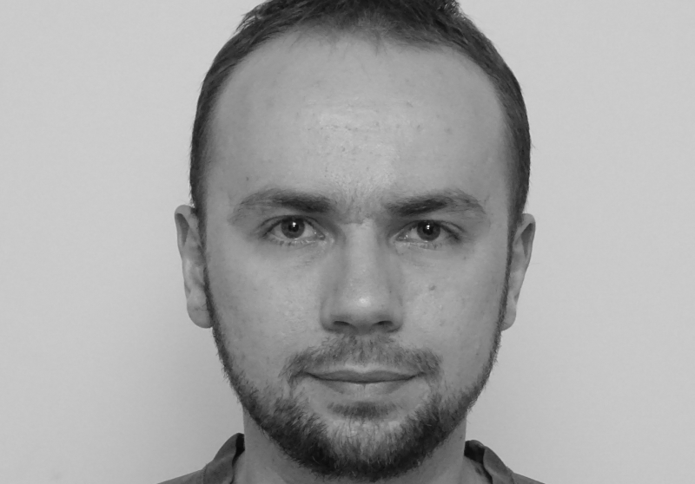
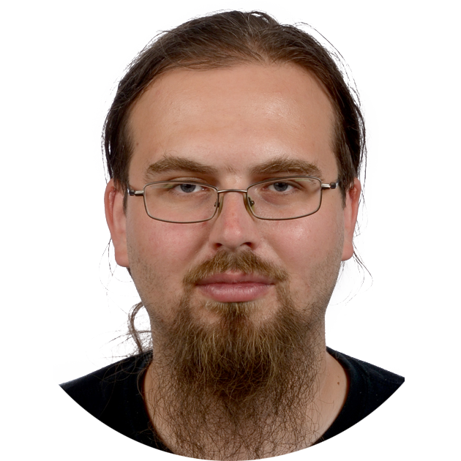
Developer vs. Admin
Vs.
Wants the newest software available
Cares for speed
Thinks about software
Usability
Wants the most tested software
Cares for stability
Thinks about hardware and OS
Security

Slide 3

Developer vs. Admin
I need the Lib_hiper_stuff-0.3.2-beta library on my server!

Slide 4

Developer vs. Admin
Hey, I need to take your server offline for maintance…
… Maybe an hour downtime, max

Slide 5

What saved us? (From hitting each other with a keyboard)

Slide 6

Developer vs. Admin
I need a new version of…
And this project requires this library…
I need a new machine with…
Oh, a new database that…

Slide 7
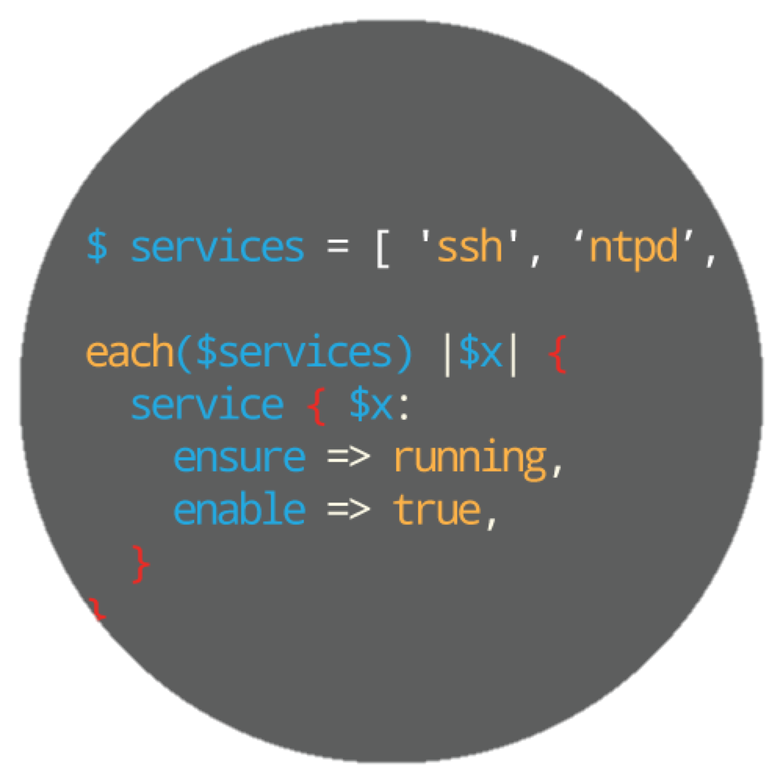
What saved us? (from a lot of manual work)
Infrastructure as Code

Slide 8

Our new tools

Slide 9
Vagrant
Making VMs great again!

Slide 10
Docker
How I fell in love with system containers

Slide 11

Live coding workshop!

Slide 12
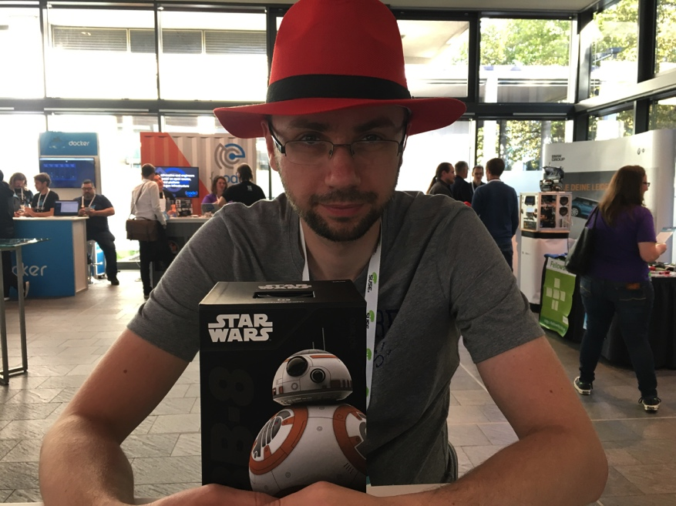
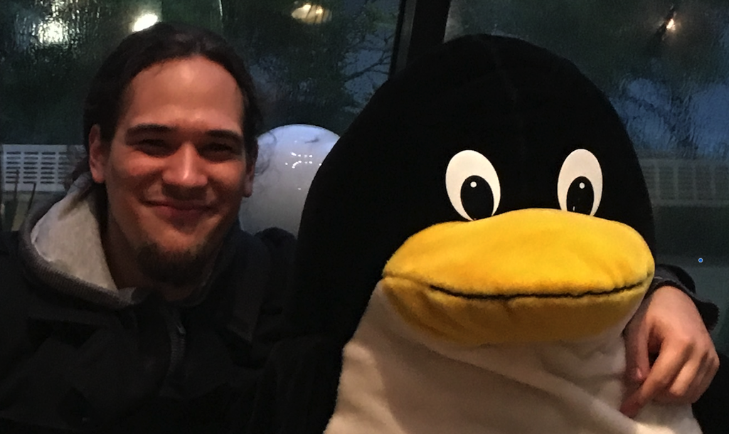
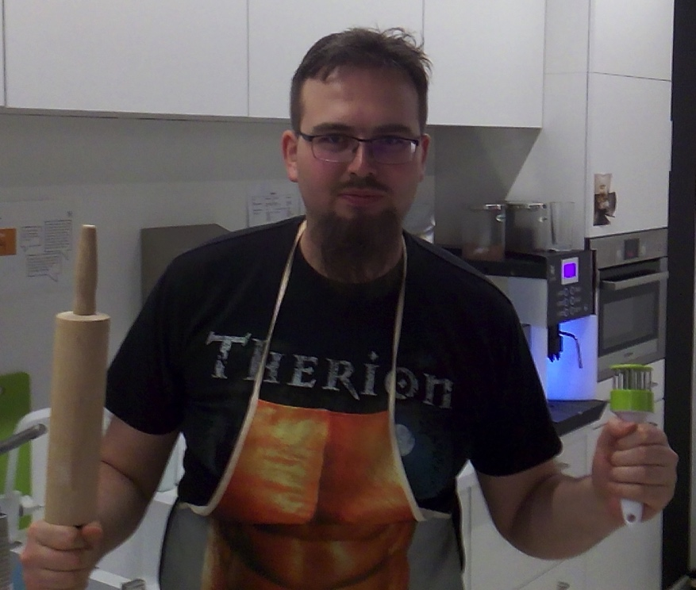
Your presenters
Adam Wałach
Jakub Błaszczyk
Artur Fijałkowski

Slide 13



Hackin' Gliwice
Pierwsza konferencja 4 Kwietnia 2017, start 17:30
How we have created 360 client customer view using graph, nosql and microservice architecture
Kolejne wydarzenia jeszcze w tym roku
Hackin' Gliwice
http://hackingliwice.pl
Notes:
- darmowa konferencja
- znane osoby w swiecie IT
- po pracy /studiach,start 17:30
-nie tyko prezentacje techniczne (np.Scrum)
- 1 konferencja 1 kwietniu,nastepna w czerwcu.
- obserwujcie nas na FB I nasza strone

Slide 14

SAP
HYBRIS

